Slide 1


Factor Analysis on Health and Wellbeing
Michael Oppong
9/25/2023

Slide 2
Variables Used in Factor Analysis
FRUITS_VEGGIES
DAILY_STRESS
PLACES_VISITED
CORE_CIRCLE
SUPPORTING_OTHERS
SOCIAL_NETWORK
ACHIEVEMENT
DONATION
BMI_RANGE
TODO_COMPLETED
FLOW
DAILY_STEPS
LIVE_VISION
SLEEP_HOURS
LOST_VACATION
DAILY_SHOUTING
SUFFICIENT_INCOME
PERSONAL_AWARDS
TIME_FOR_PASSION
WEEKLY_MEDITATION

Slide 3
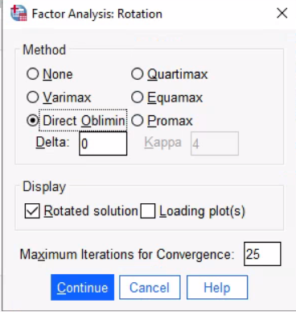
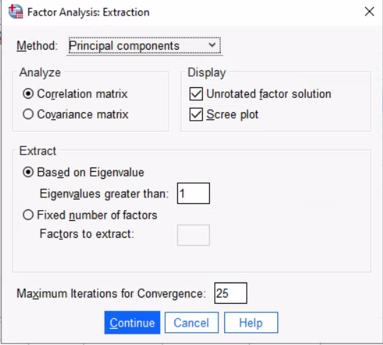
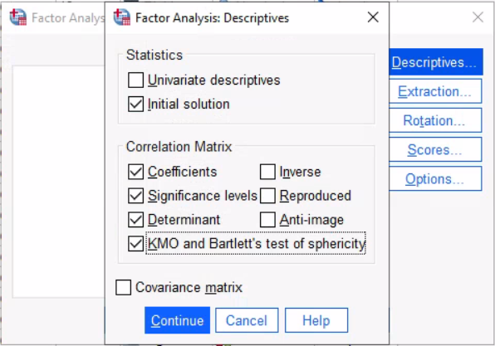
Dimension Reduction (Analysis)
We start with Oblique(Direct Oblimin), there is a chance we will come back and modify to an Orthogonal (Varimax) later

Slide 4
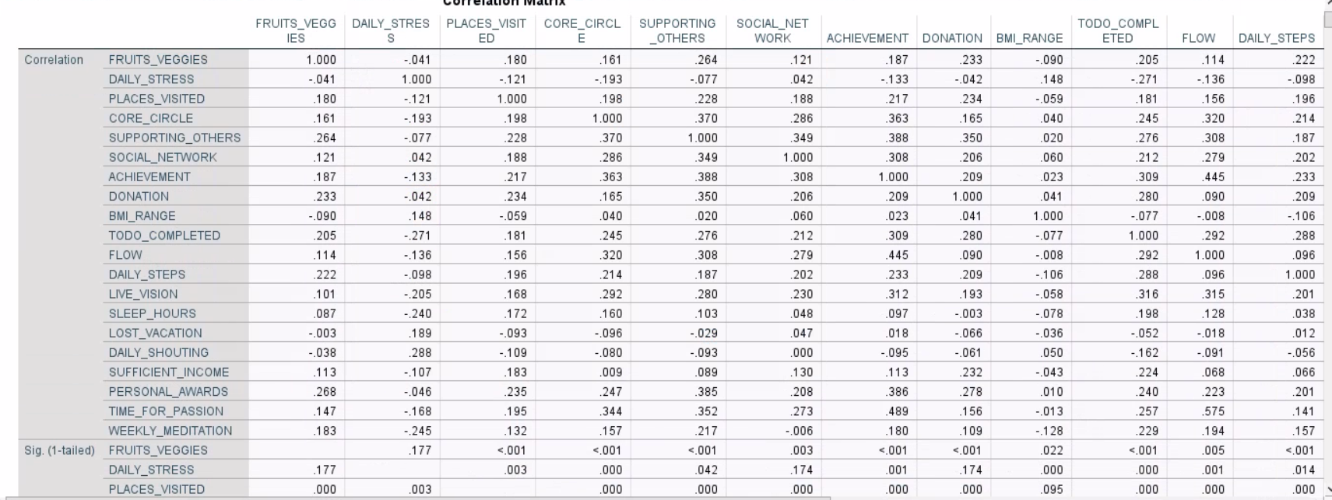

Slide 5
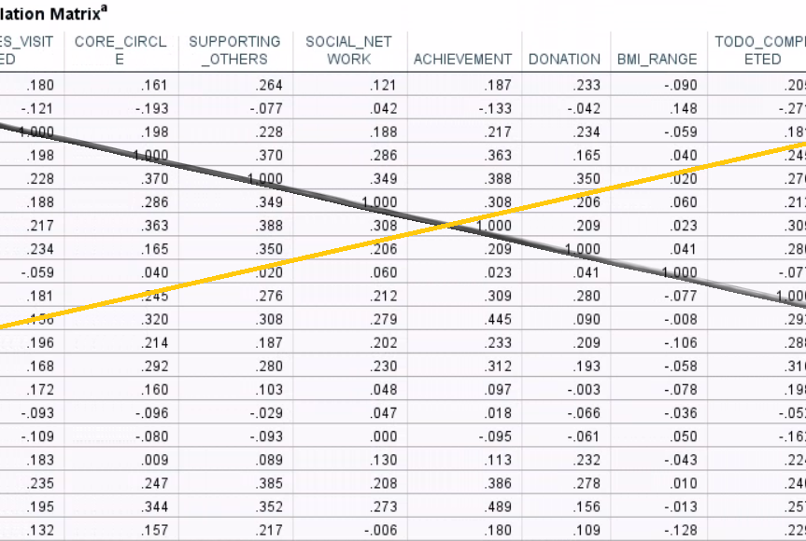
The 1’s running through is called the principal diagonal. It shows that there is a perfect relationship between variables.
The Correlation between x and y is the same as the correlation between y and x.

Slide 6
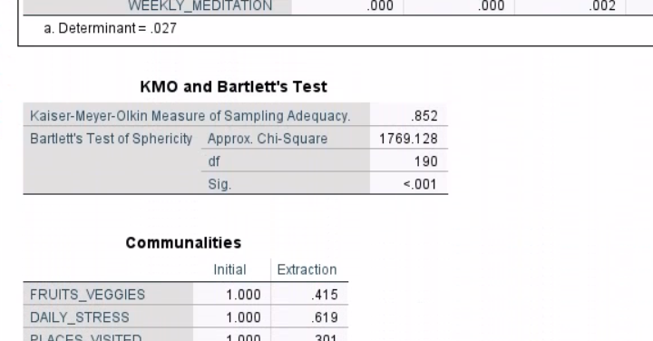
The value for the determinant is an important test for multicollinearity or singularity. The determinant of the correlation matrix should be greater than .00001
The KMO test is a measure of whether the distribution of values based on the sample is adequate for conducting a factor analysis. This test indicates the amount of overlap or shared variance between pairs of variables (>0.5)
The Barlett’s test is designed to determine if the correlation matrix is an identity matrix (where all correlation coefficients are 0)
A significant value (less than .05) indicates that the data do not produce an identity matrix indicating there are adequate relationships between variables to conduct the factor analysis

Slide 7
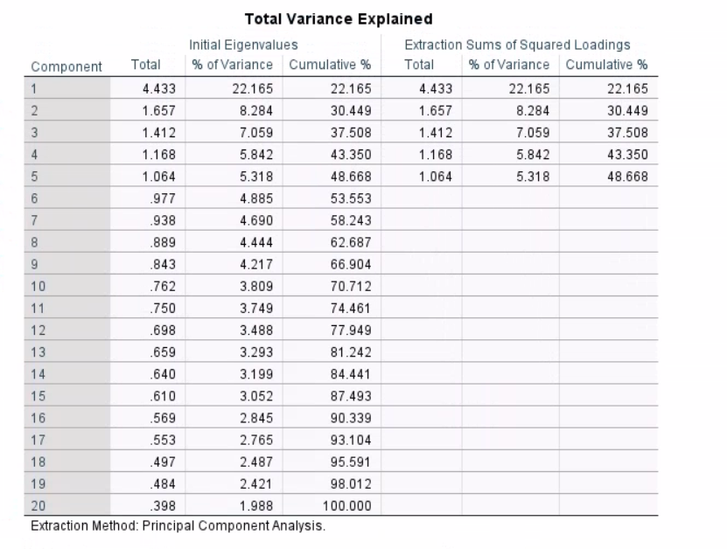
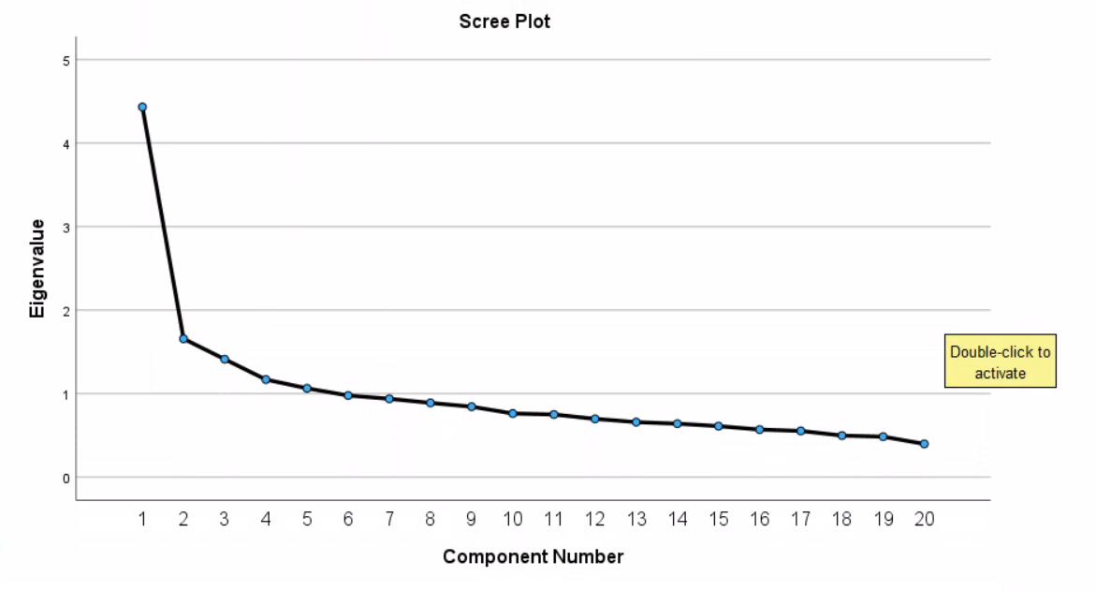
An Eigenvalue of 1 or better than 1 means that the factor consist of more than 1 single variable

Slide 8
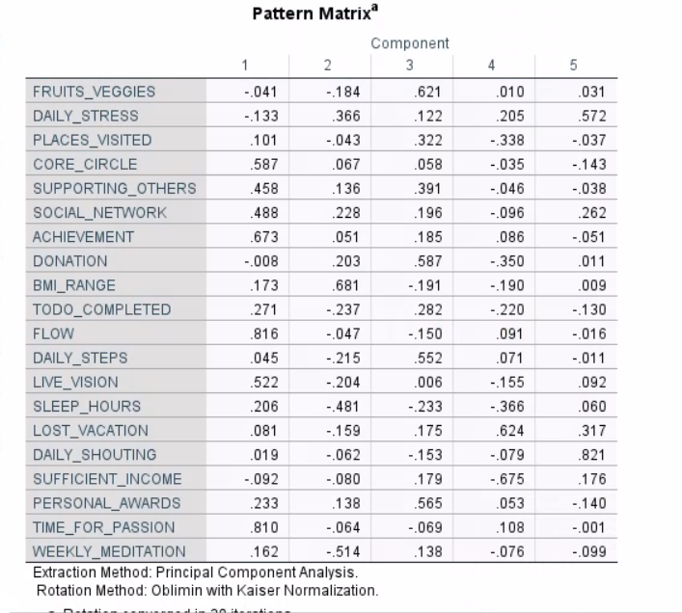
There are identifiable patterns in the components.
In each component you can see heavily loaded variables and those that are lightly loaded

Slide 9
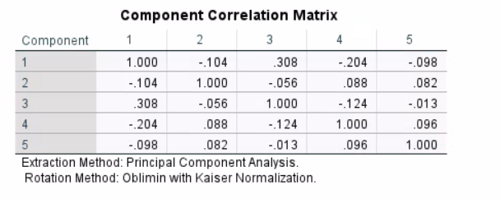
The component correlation matrix presents the correlation between the extracted factors / components and is thus important for choosing between orthogonal and oblique rotation.
In using Oblimin, If we get values less than 0.32, we need to redo the analysis.

Slide 10
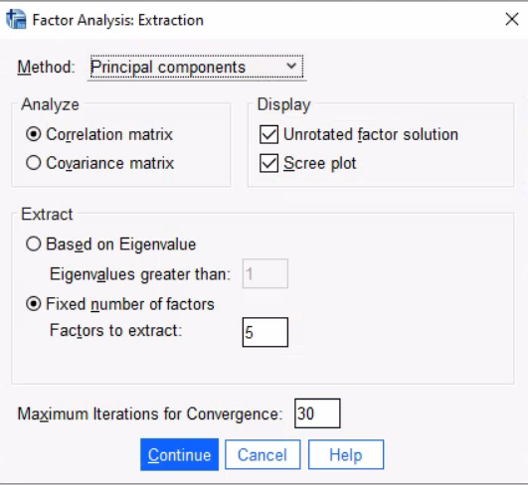
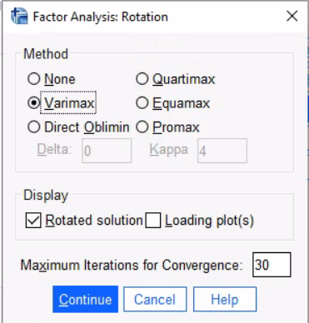
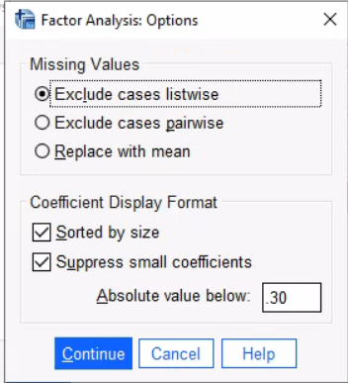
Fixed Number of Factors: This is because we can see 5 components that are correlated
Sorted by size: This helps us to group correlated values in an orderly manner.
Suppress small coefficients: This takes away values that are way too small in order to make our other values more visible when grouped

Slide 11
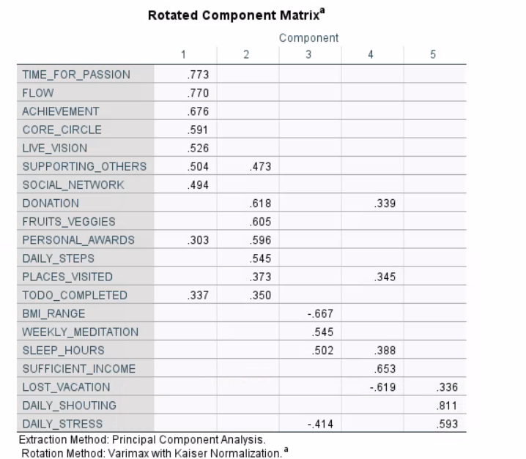
I: Time for passion, Flow, Achievement, Core Circle, Live Vision, Supporting Others, Social Network
II: Donation, FruitsVegies, Personal Awards, Daily Steps, Places Visited, To-Do Completed
III: BMI, Meditation, Sleep Hours
IV: Sufficient Income, Lost Vacation,
V: Daily Shouting, Daily Stress

Slide 12
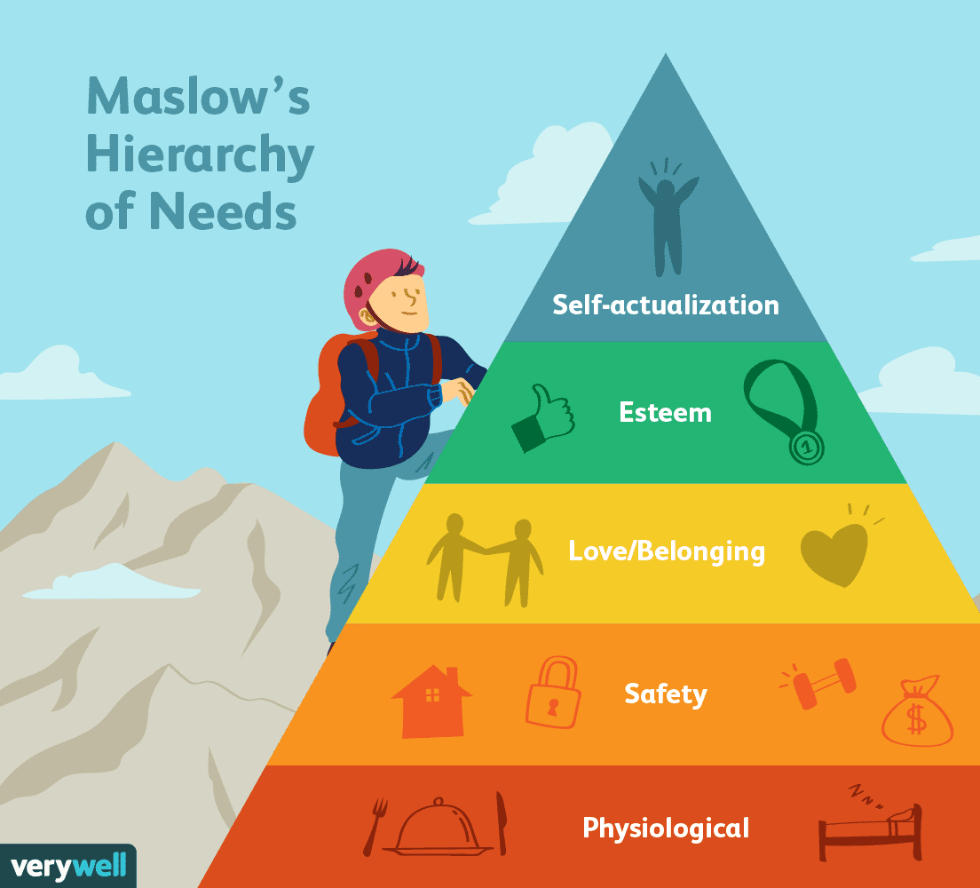
The 5 thematic areas of classification of these components. They aligned so well with Maslow’s Theory!
Instead of 20 original values, we now have 5 factors which can be called constructs.
The beauty of Dimension Reduction; 20 variables to 4 or 5 constructs

Slide 13
Conclusion
I. What have we learned ?
Factor Analysis allows us to simplify a set of complex variables using statistical procedures to explore underlining dimensions that explain relationships between the multiple variables
II. What have we gained by this process ?
We have put 20 variables into 5 constructs, making it easy for classification and decision making.
III. How can we use the newly identified factors ?
It will guide our go-to market strategy, give us insights into pain points based on people’s needs prioritization

Slide 14

Thank You.
I’ll take some questions now.

